Slide 1
Detecting 3D Objects Using Apple’s LiDAR Sensor
By Fei Xie and Chris Kelly

Slide 2
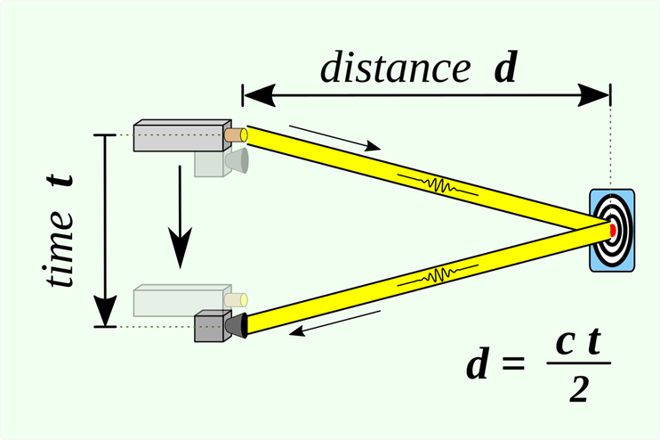
How does LiDAR work
Time of Flight
Colidar works by using laser pulses
Pulse reflects off target and returns to a detector
Can calculate Distance with equation D = c*t/2

Slide 3
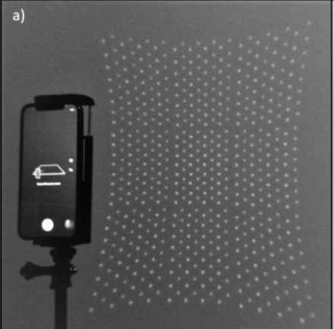
Apple’s LiDAR Sensor and its Capabilities
Using time of flight calculations LiDAR is able to find how far away an object is
Sensor produces an 8 × 8 points diffracted into 3 × 3 grids making a total of 576 depth points (1)
LiDAR makes 3D scanning much easier and cheaper than ever before

Slide 4

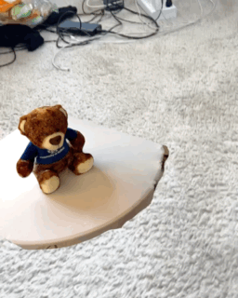
Scanning Demonstration
Using the Polycam application and Lidar sensor a 3D model was constructed
Able to place 3D scan into Augmented Reality landscape
Useful for cheap yet detailed 3D scans of products/prototypes
Applications for Virtual Reality

Slide 5
New Research and Applications
Remote sensing in Geoscience (1)(2)
Low cost scanning for terrestrial landscapes, monitoring erosion of coastal cliffs
Yield monitoring systems in agriculture
Detailed sensing in fruit(3) and crop productions.
Forest management (4)
Identifying Objects through LiDAR scans

Slide 6
Reference
Luetzenburg, G., Kroon, A. & Bjørk, A.A. Evaluation of the Apple iPhone 12 Pro LiDAR for an Application in Geosciences. Sci Rep 11, 22221 (2021). https://doi.org/10.1038/s41598-021-01763-9
E. Zawacki, “IPhone LIDAR with applications for the Geosciences,” OpenTopography, 12-Jan-2022. [Online]. Available: https://opentopography.org/blog/iphone-lidar-applications-geosciences. [Accessed: 13-Sep-2022].
Tsoulias, Nikos, et al. "Apple shape detection based on geometric and radiometric features using a LiDAR laser scanner." Remote Sensing 12.15 (2020): 2481.
Tatsumi, S., Yamaguchi, K., & Furuya, N. (2022). ForestScanner: A mobile application for measuring and mapping trees with LiDAR-equipped iPhone and iPad. Methods in Ecology and Evolution, 00, 1– 7. https://doi.org/10.1111/2041-210X.13900

